Slide 1



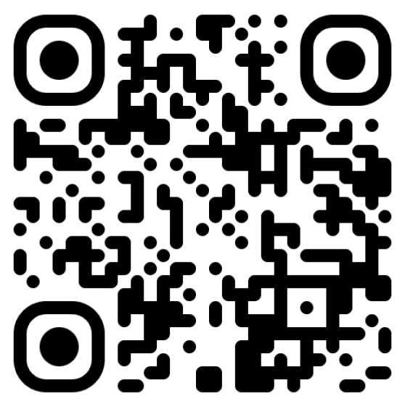



DEVELOPING MULTI-TENANT APPLICATIONS WITH .NET AND ABP FRAMEWORK
QR (Optional)
Name
Title
username
username

Slide 2

TITLE
Content
1
2
2.1
2.2
2.2.1
2.2.2

Slide 3
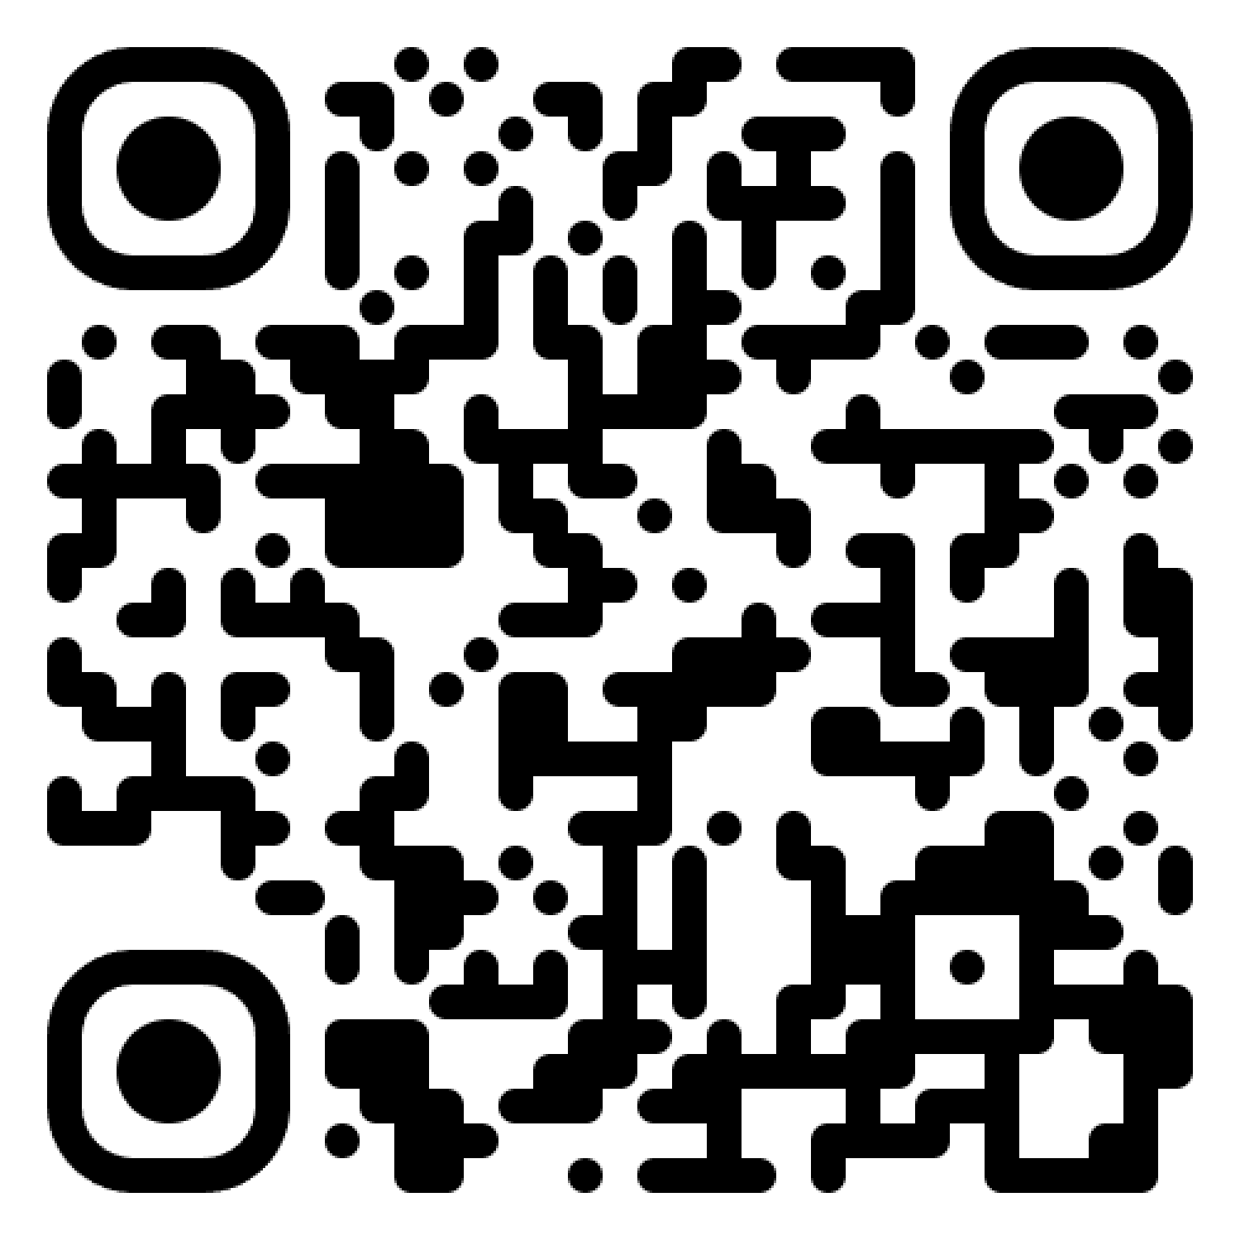
THANKS FOR
LISTENING
QR (Optional)
Name
Title
username
username

